Slide 1

Digital Skills Wallet for Rural High School Engagement
Industry Project IFN711
By Team 18
Karma Samdrup: n11704209
Tshewang Chophel: n11716932
Phuntsho Choden: n11661429
Kala Maya Sanyasi: n11729007
Tshewang Tenzin: n11761211
Tandin Bidha: n11685719

Slide 2
Problem and solution
Problem statement:
Rural schools lack platforms to deliver industry-relevant digital skills and securely verify student credentials, with ongoing concerns around privacy and data protection.
Proposed solution:
A blockchain-powered web app that helps rural schools securely issue and verify student credentials with integrity and trust.
The system uses authentication and Zero-Knowledge Proof to verify student skills while protecting their personal information, ensuring privacy and security.

Slide 3
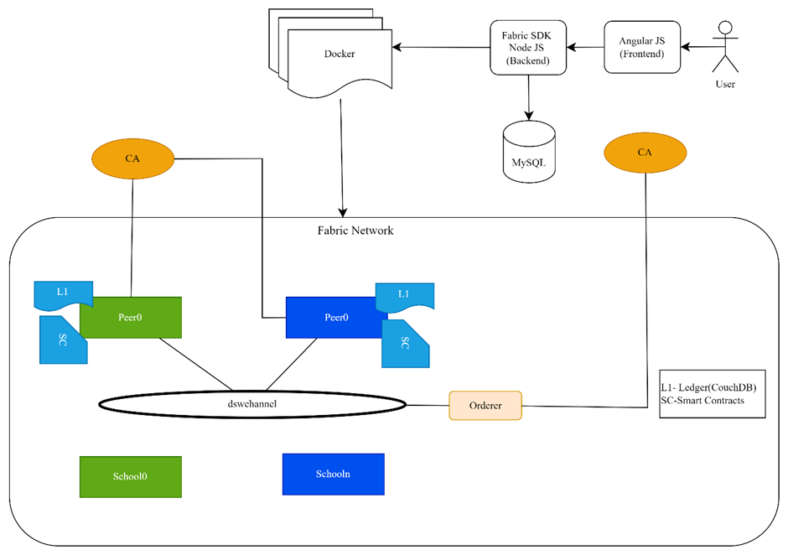
System Architecture

Slide 4
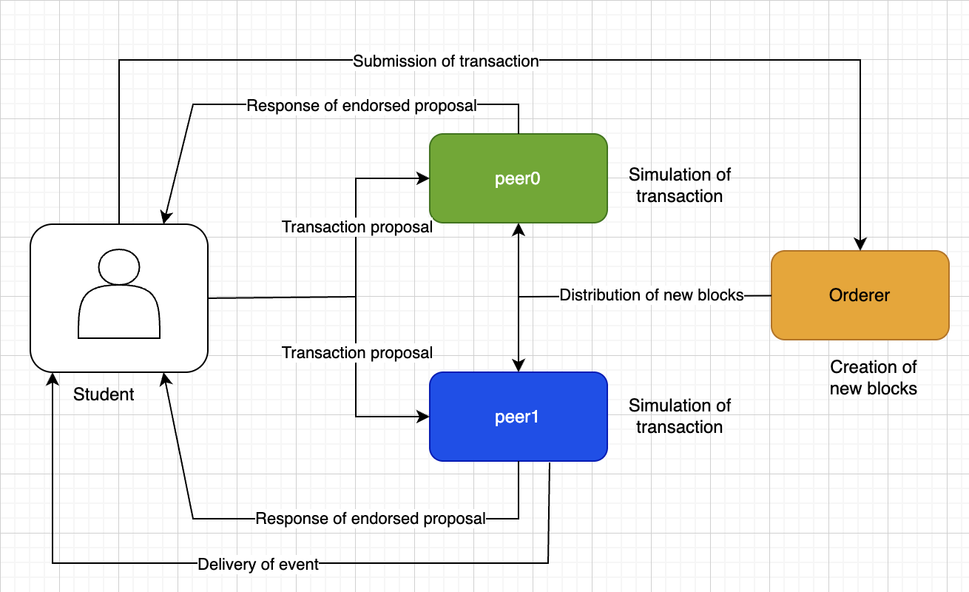
Flow Model
Notes:
User login
The system will allow student/school to login using username and password and access role-based dashboard.
Secure score with ZKP:
The system must allow student to prove their test performance without revealing actual score.

Slide 5
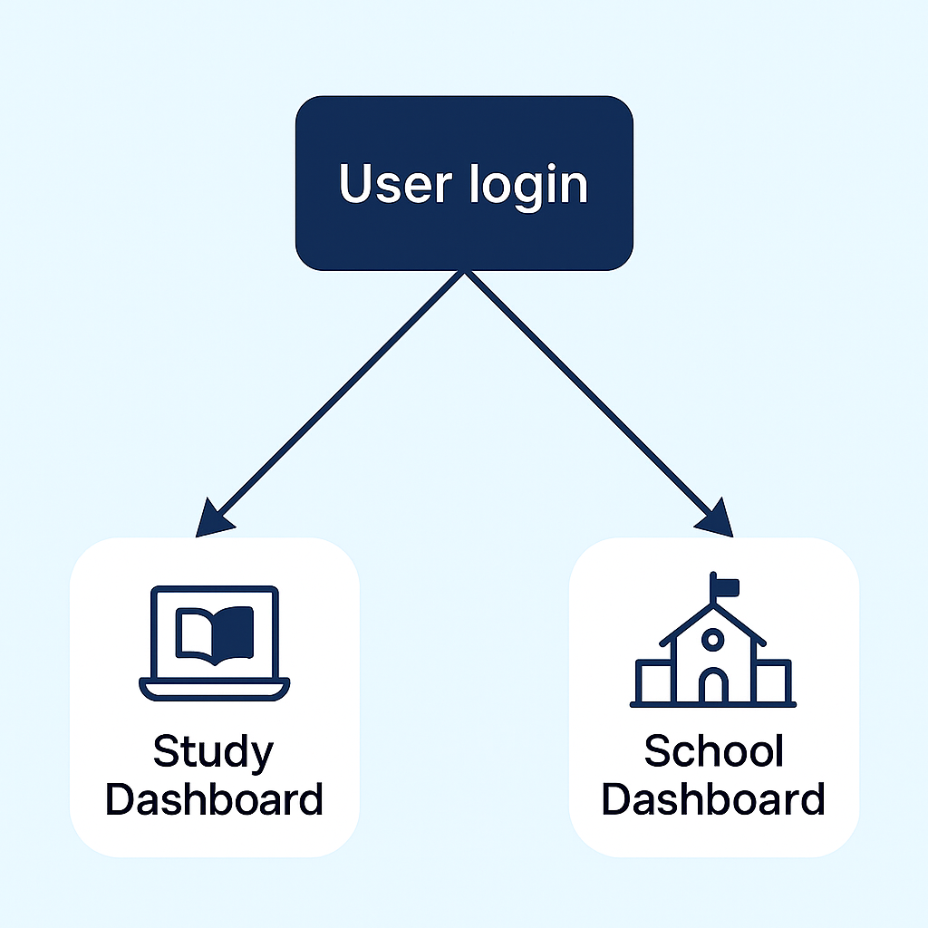
Functional Requirement
User login: system will allow users to login using username and password.
Login page is implemented using frontend Angular and dummy backend data with respective role. Role-based access will allow student and school to see different dashboard.
Notes:
User login
The system will allow student/school to login using username and password and access role-based dashboard.
Secure score with ZKP:
The system must allow student to prove their test performance without revealing actual score.

Slide 6
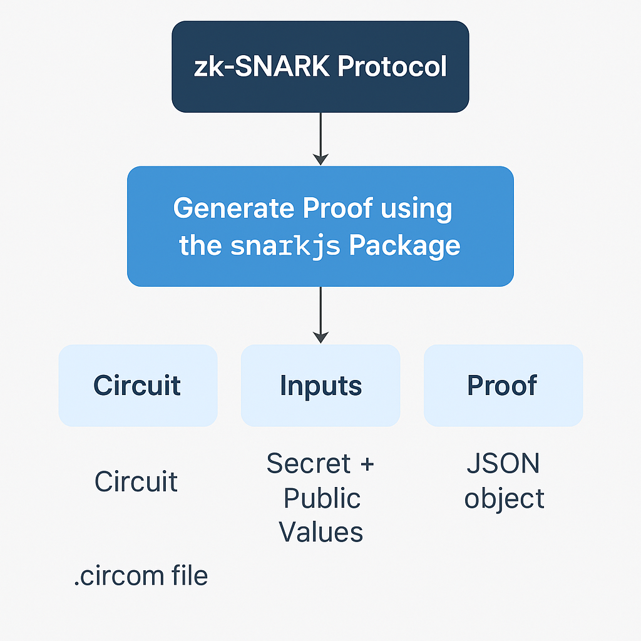
Functional Requirement
Secure score with ZKP: system will allow student to validate the score without revealing actual score.
Dummy scores are evaluated using Circorn circuit and snarkjs is used to generate ZKP proof. To verify securely, proof + public signals are sent to the backend.
Test Verification by school: school must verify the test taken by students.school can view the test record of the student and click to verify the test which will then change the status of the test.
Notes:
User login
The system will allow student/school to login using username and password and access role-based dashboard.
Secure score with ZKP:
The system must allow student to prove their test performance without revealing actual score.

Slide 7
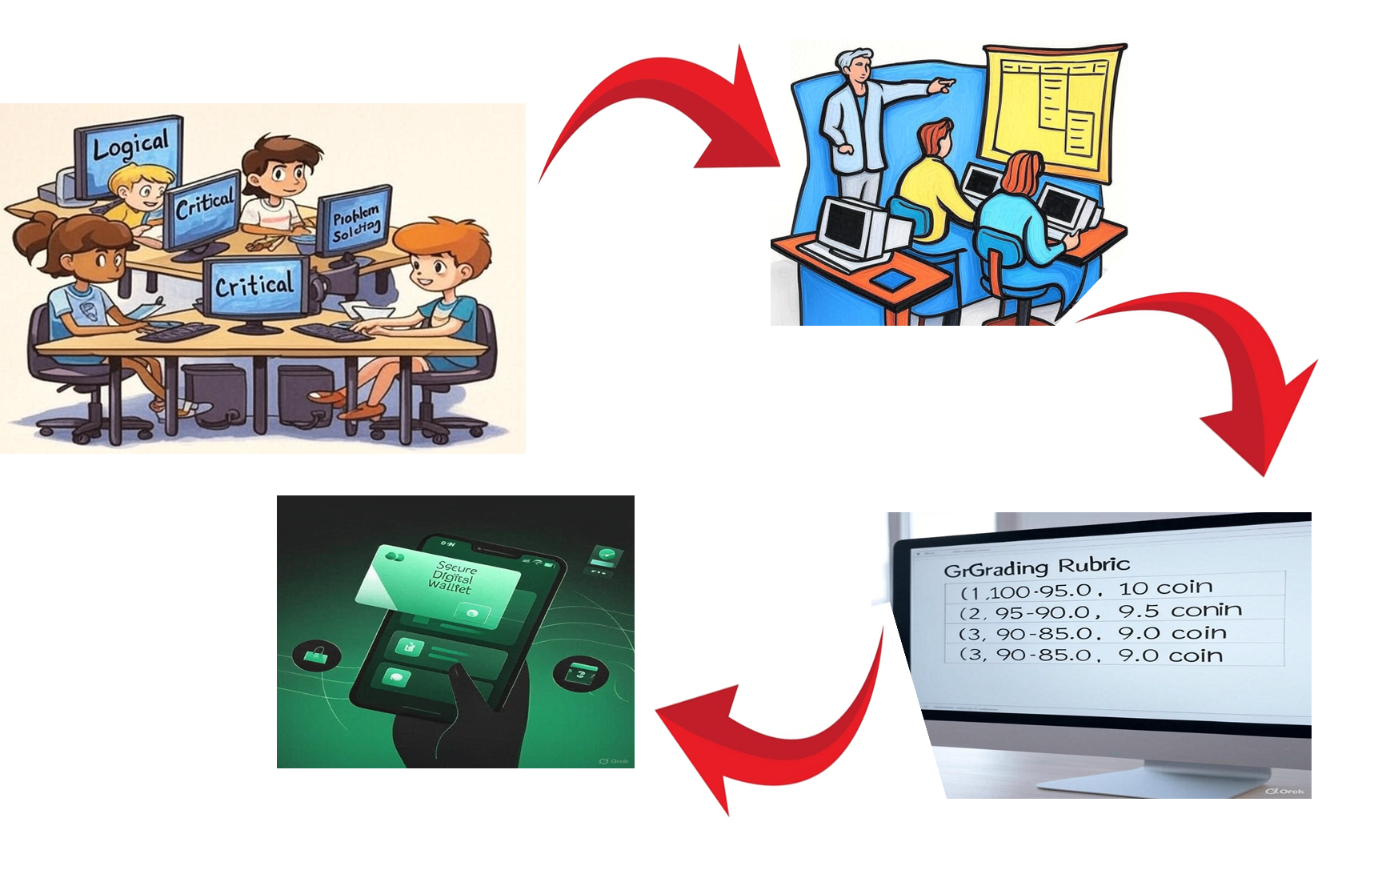
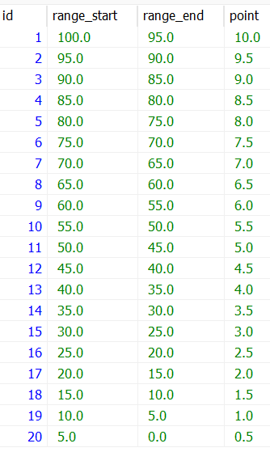
Functional Requirement
CRA: Criterion-Referenced Assessment
Notes:
User login
The system will allow student/school to login using username and password and access role-based dashboard.
Secure score with ZKP:
The system must allow student to prove their test performance without revealing actual score.

Slide 8
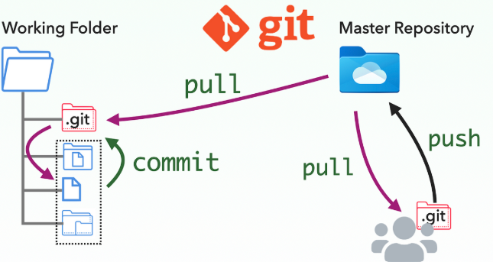
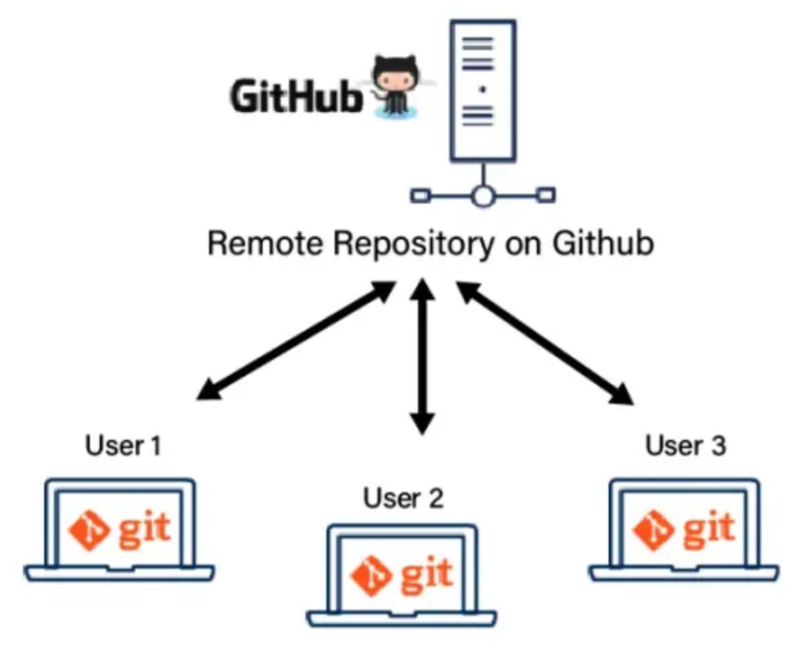
Functional Requirement
Git and Github
Notes:
User login
The system will allow student/school to login using username and password and access role-based dashboard.
Secure score with ZKP:
The system must allow student to prove their test performance without revealing actual score.

Slide 9
Reflection & Project Learning
Learnings:
•Hands-on experience in setting up and managing Hyperledger Fabric
•Security Awareness
•Collaborative Problem Solving
Challenges:
Setting up Hyperledger as a beginner.
Implementing and learning ZKP in blockchain security.
Time management
Area for improvement:
Implementation of security protocols(ABE)
Lessons learned:
Team Communication
Importance of Planning
Deeper understanding of blockchain and it’s privacy and security models

Slide 10
THANK YOU

